Slide 1
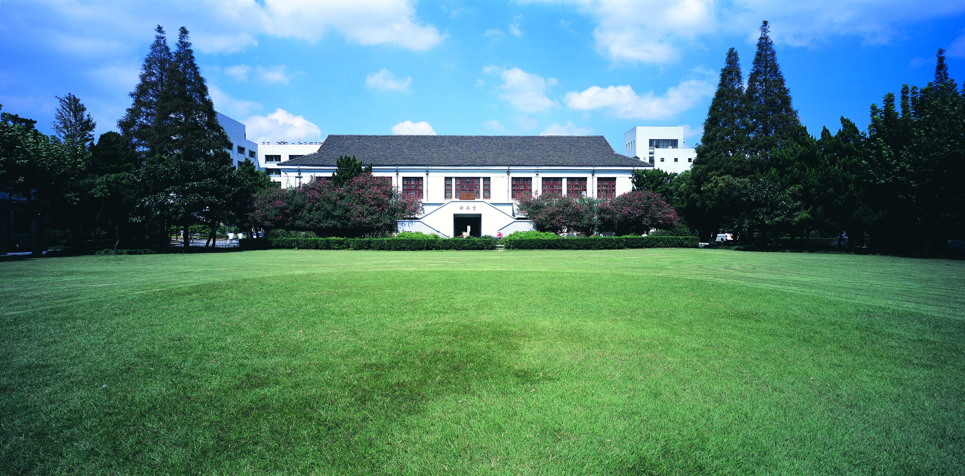
Crow Count
陈宋健

Slide 2
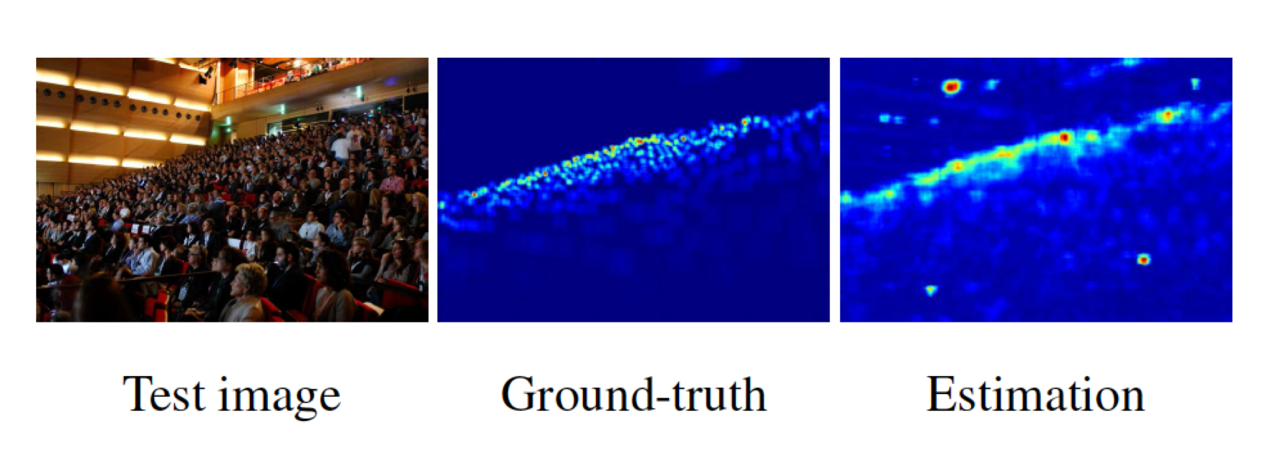
Introduction : Crowd Count

Slide 3
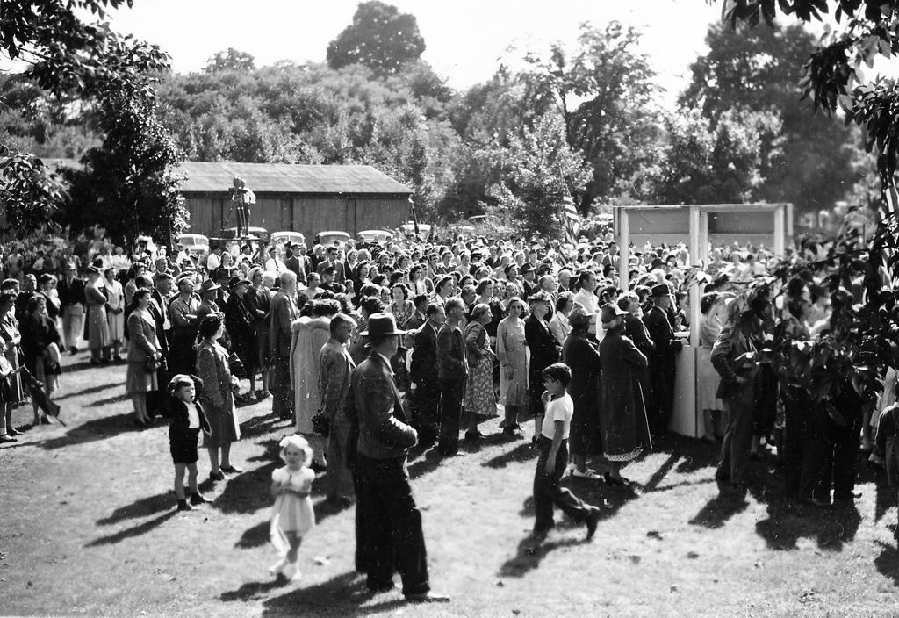
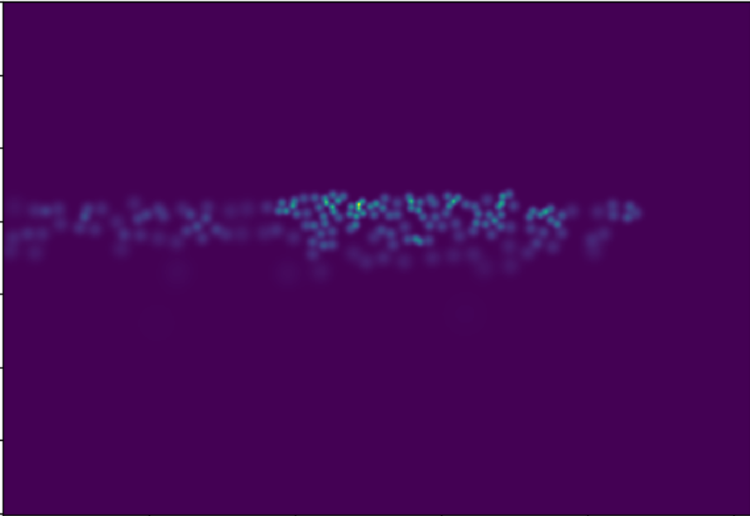
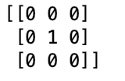
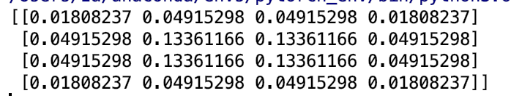
2-D Gaussian kernel

Slide 4
Models
MCNN
Top-Down Net
Scale Aggregation Net
PaD Net
CSR Net
Unlabeled
Inception

Slide 5
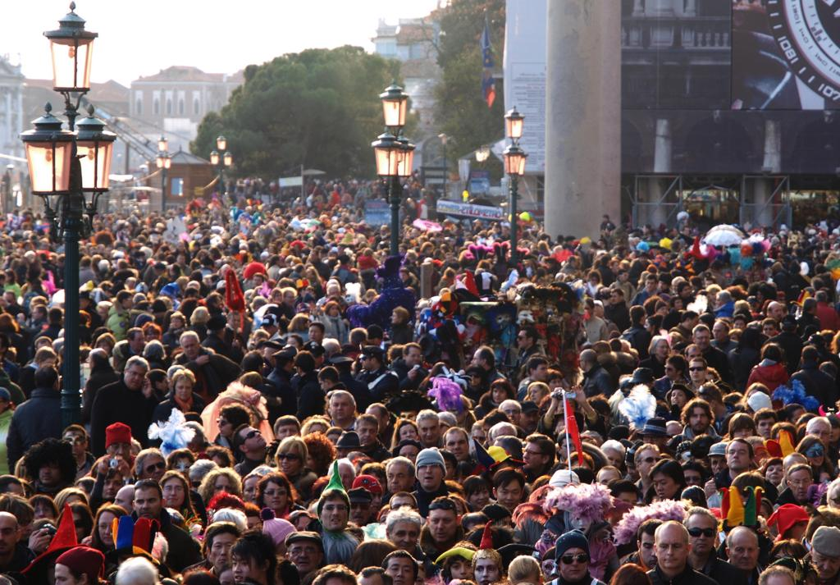
Multi-Scale

Slide 6
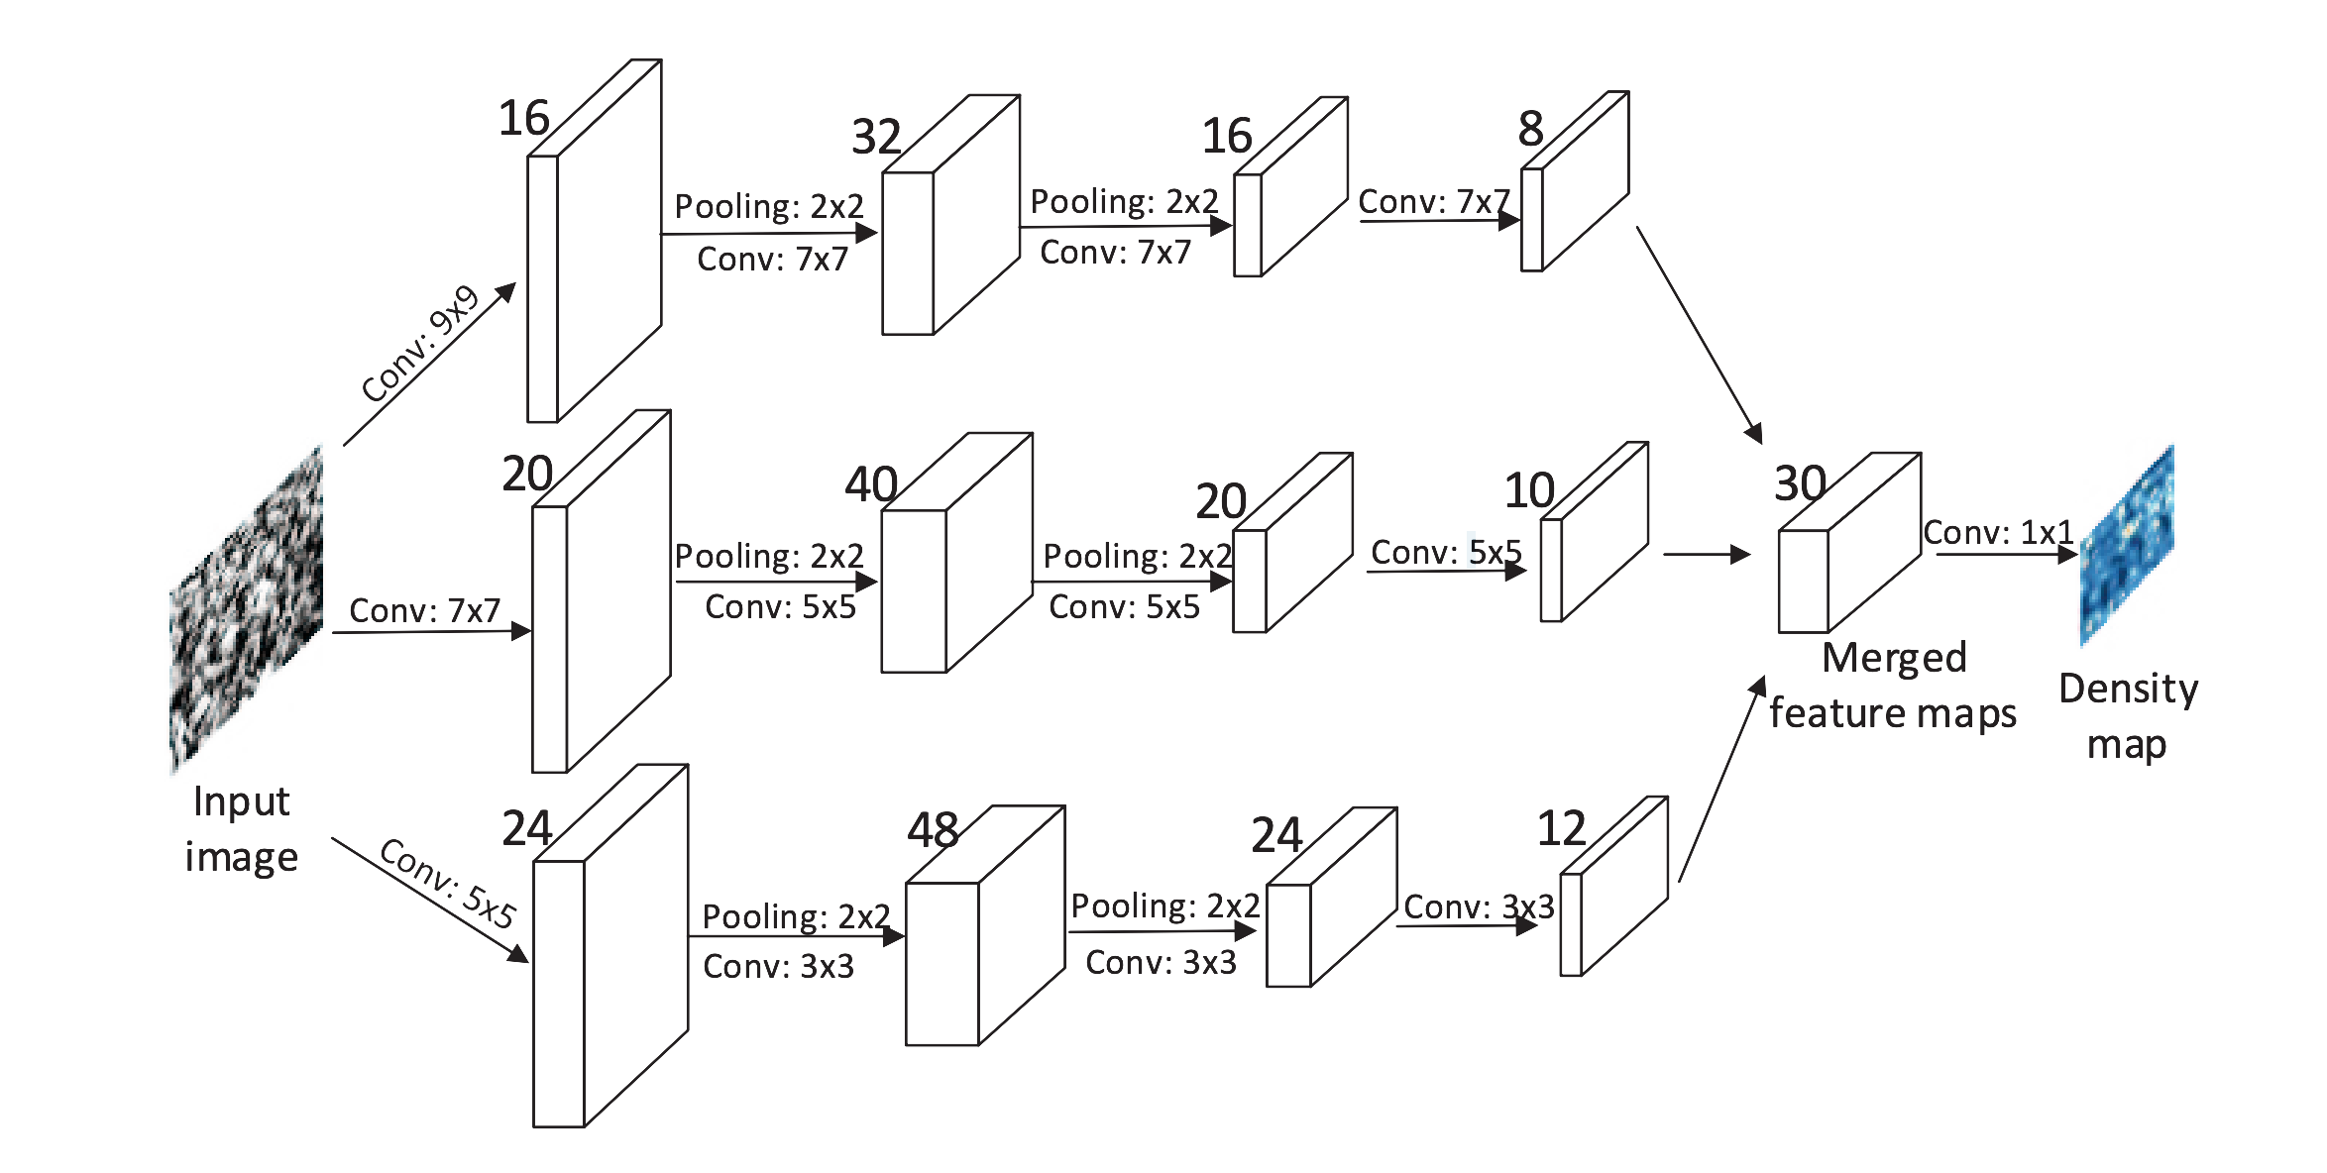
Multi-Scale(MCNN)
MCNN: Single-Image Crowd Counting via Multi-Column Convolutional Neural Network(CVPR 2016)

Slide 7
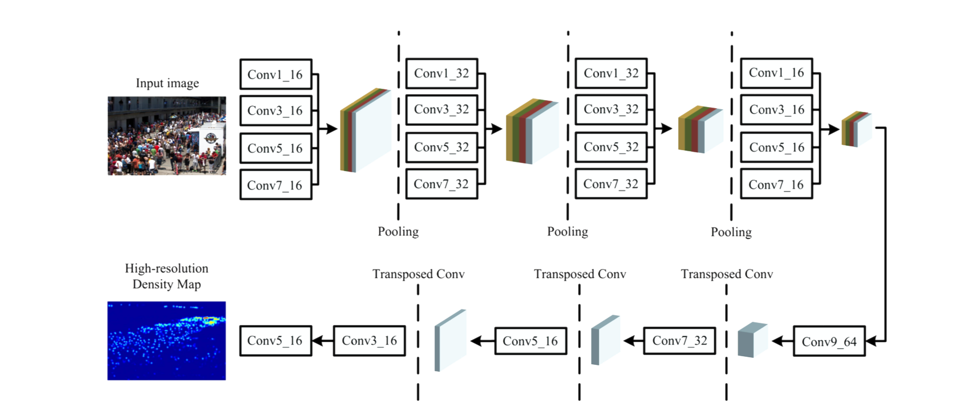
Multi-Scale(SA Net)
SANet: Scale Aggregation Network(ECCV2018)

Slide 8
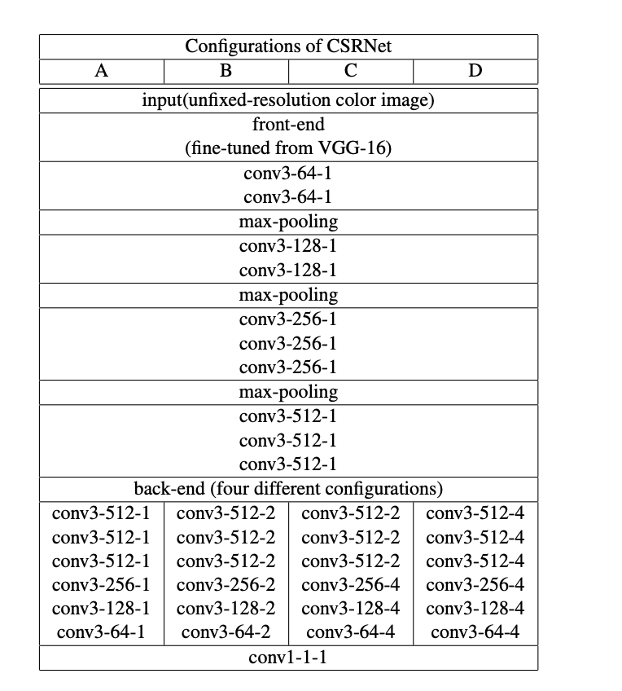
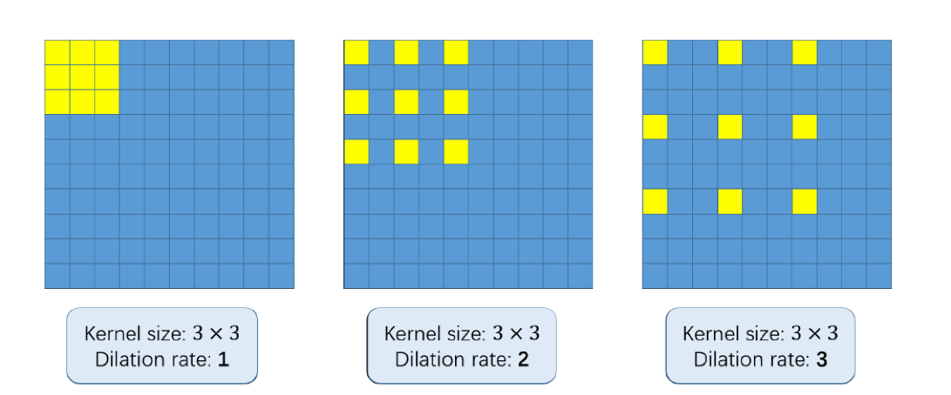
Multi-Scale(CSR Net)
Dilated Pool

Slide 9
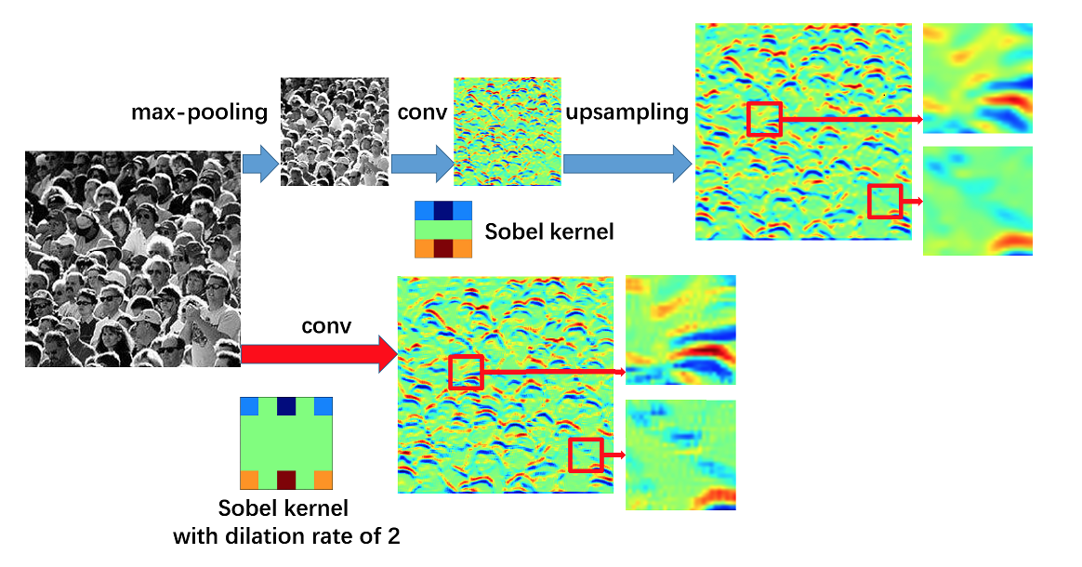
Multi-Scale(CSR Net)

Slide 10
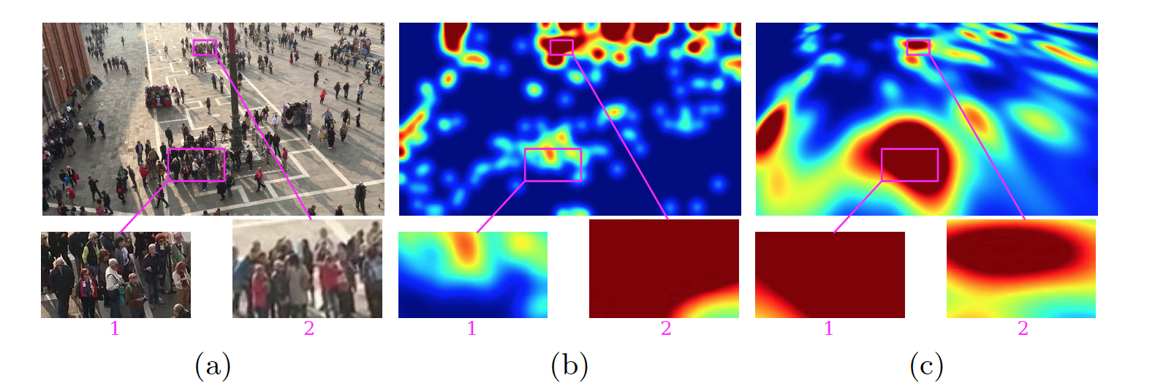
Multi-Scale
Geometric and Physical Constraints for Head Plane Crowd Density Estimation in Videos

Slide 11
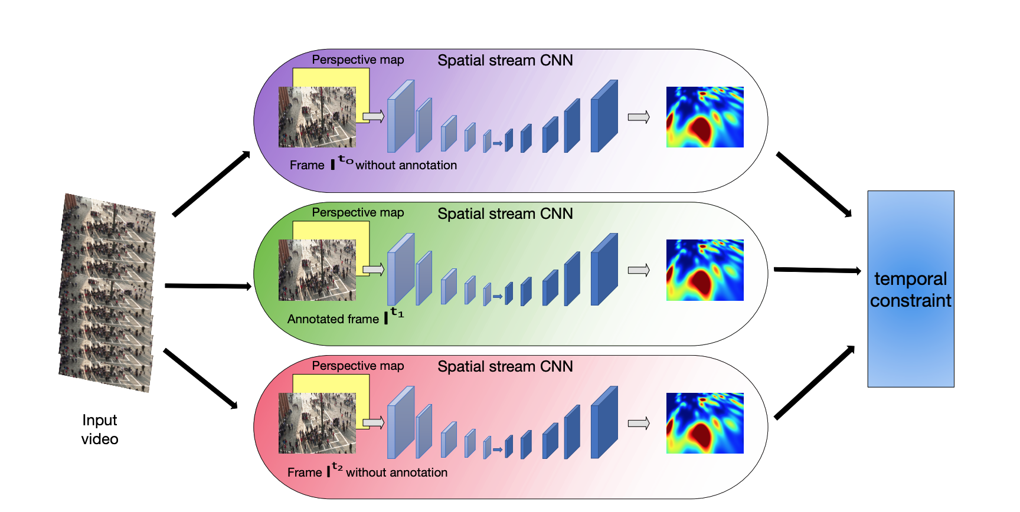
Multi-Scale
Geometric and Physical Constraints for Head Plane Crowd Density Estimation in Videos

Slide 12
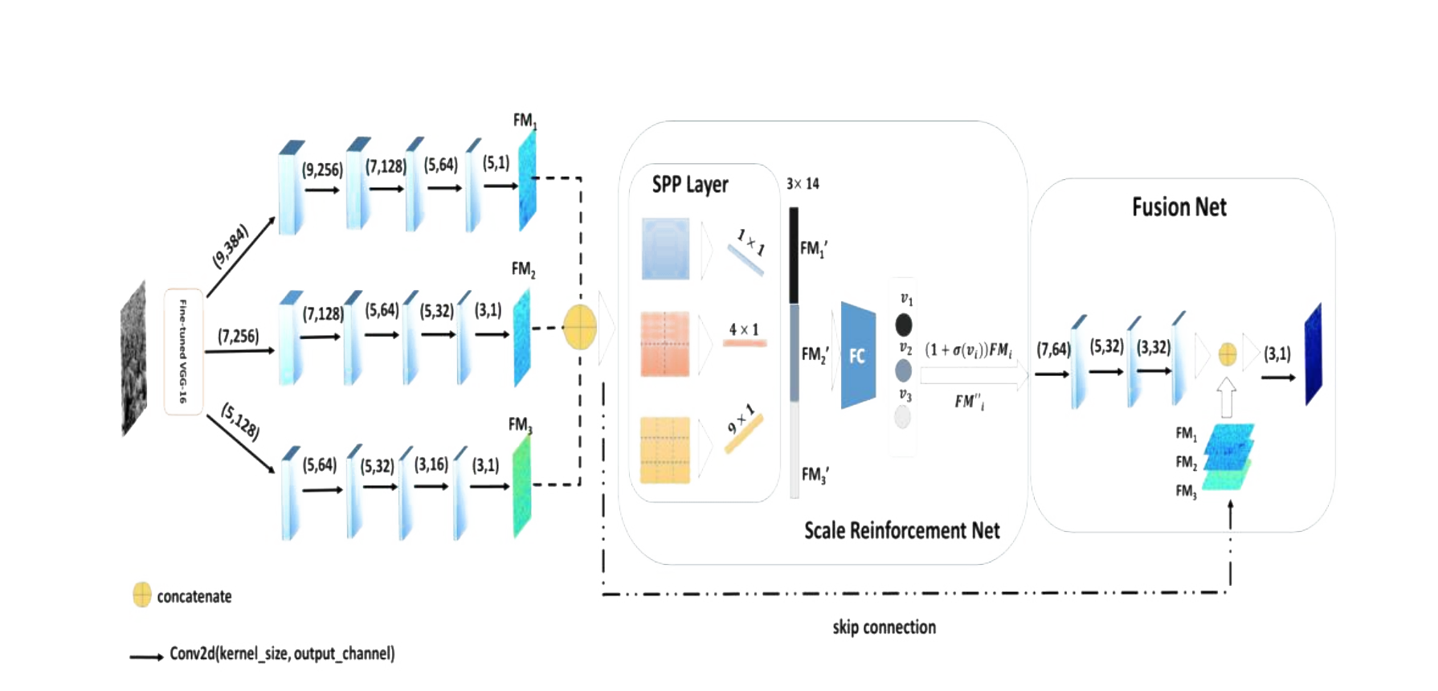
Multi-Scale(PaD Net)

Slide 13
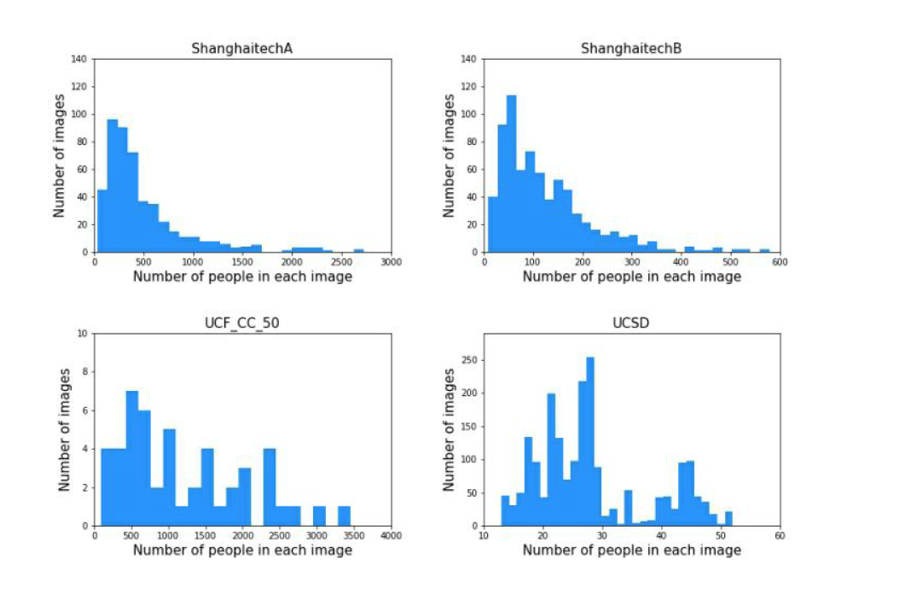
Multi-Scale(PaD Net)

Slide 14
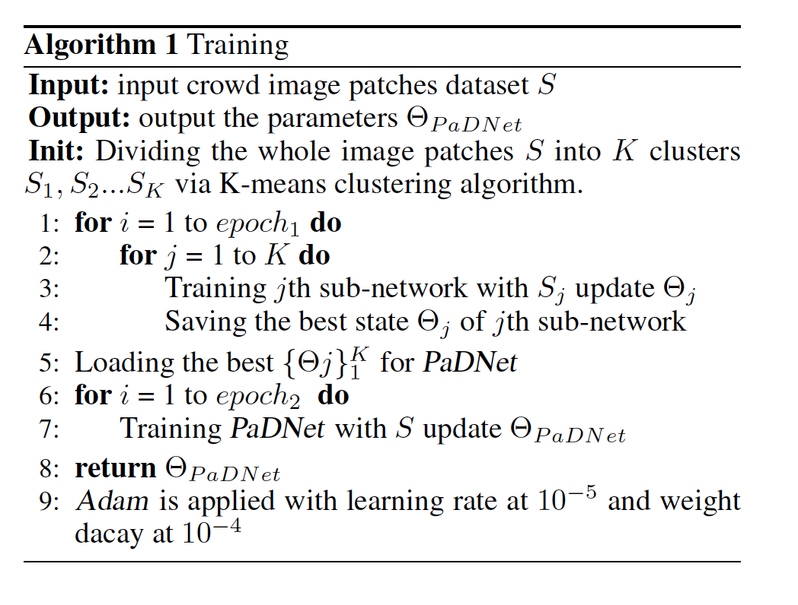
Multi-Scale(PaD Net)

Slide 15
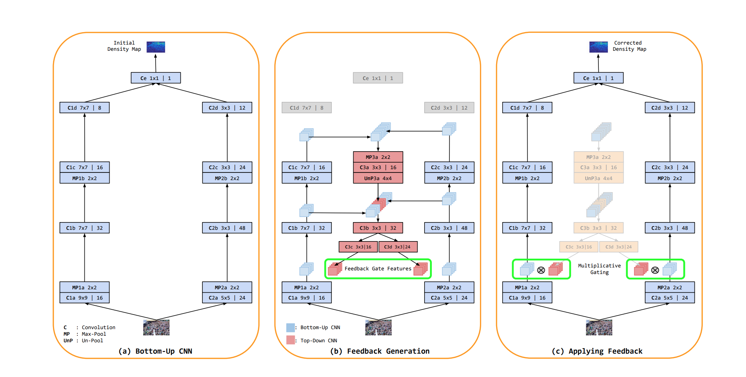
Contex(TDF Net)
Top-Down Feedback for Crowd Counting Convolutional Neural Network

Slide 16
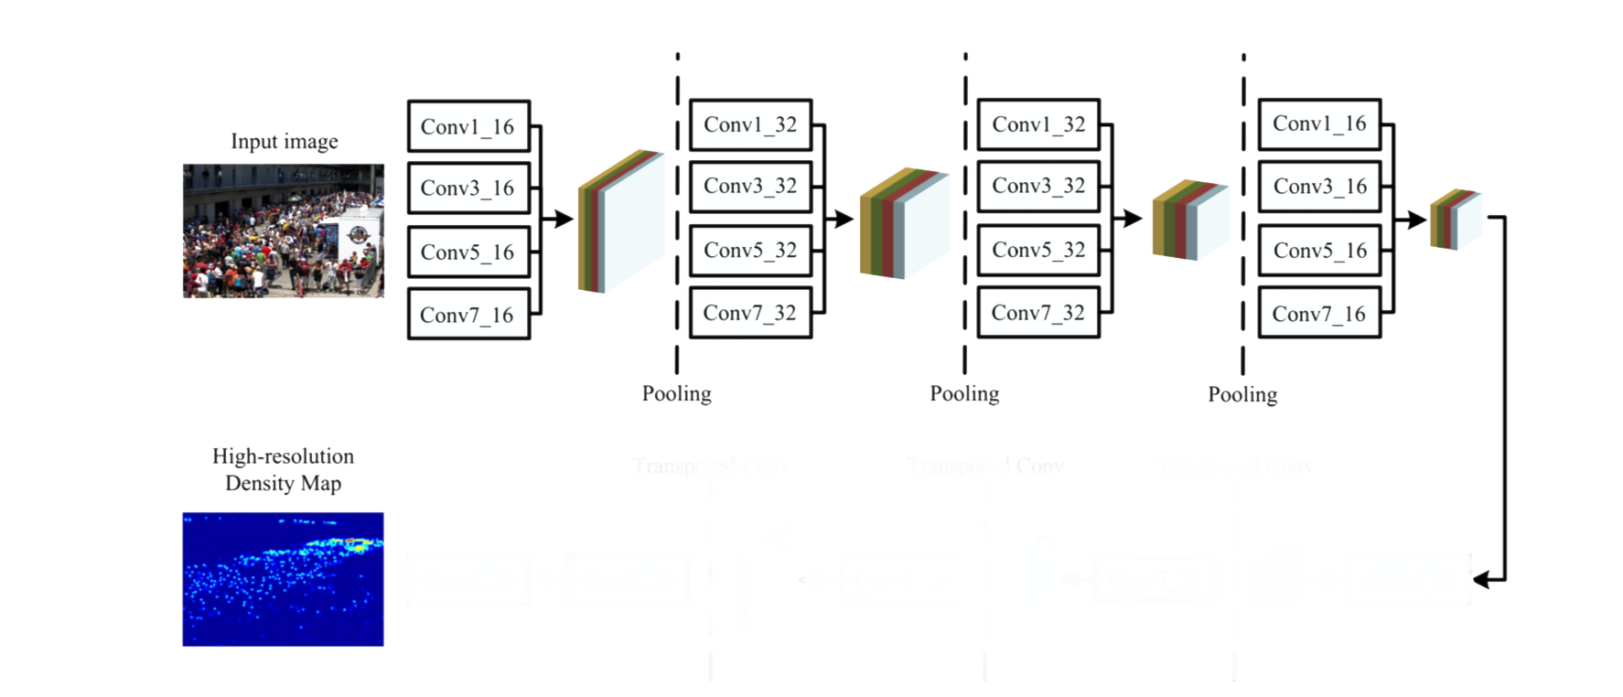
Time-based(ScaleConv2LSTM(ours))
LSTM
LSTM
LSTM
LSTM
Conv1_1

Slide 17
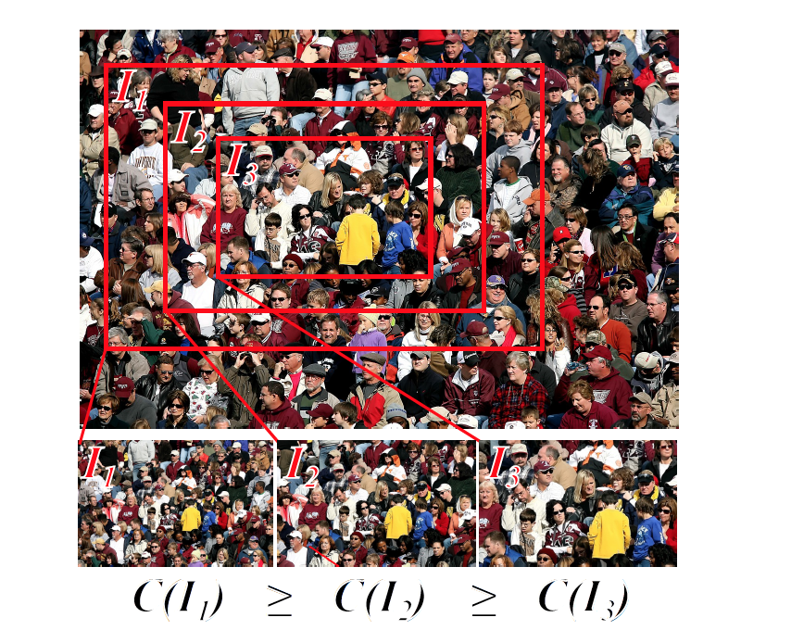
L2R: Leveraging Unlabeled Data for Crowd Counting by Learning to Rank(CVPR 2018)

Slide 18
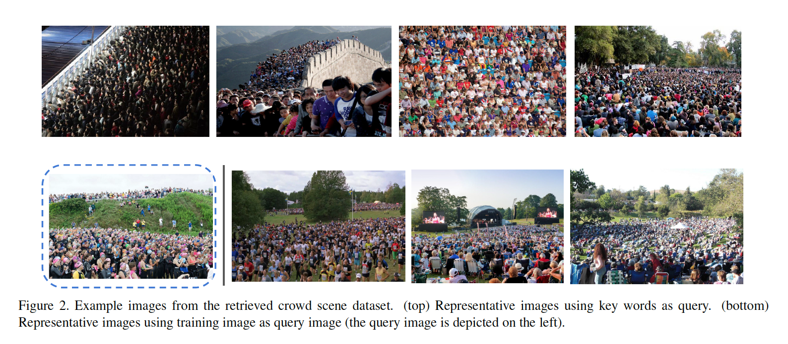
L2R: Leveraging Unlabeled Data for Crowd Counting by Learning to Rank(CVPR 2018)

Slide 19
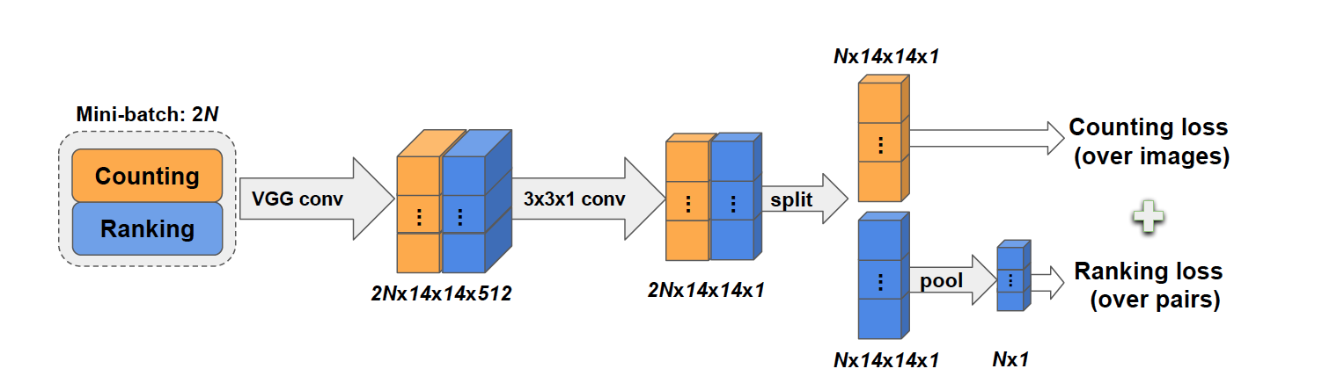
L2R: Leveraging Unlabeled Data for Crowd Counting by Learning to Rank(CVPR 2018)

Slide 20
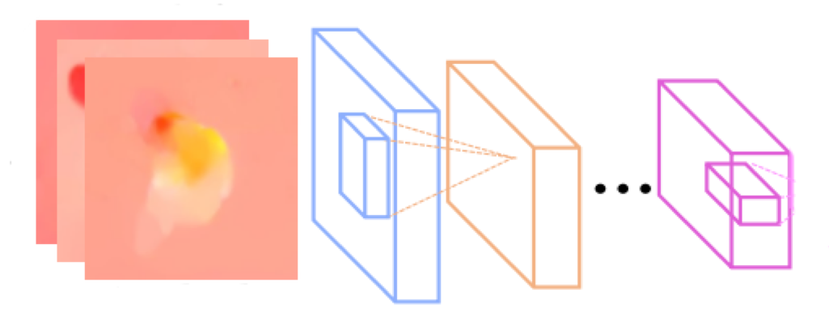
Time-based
LSTM
Optical Flow

Slide 21
Time-based(ScaleConv2LSTM(ours))
LSTM
LSTM
LSTM
LSTM
Conv1_1

Slide 22
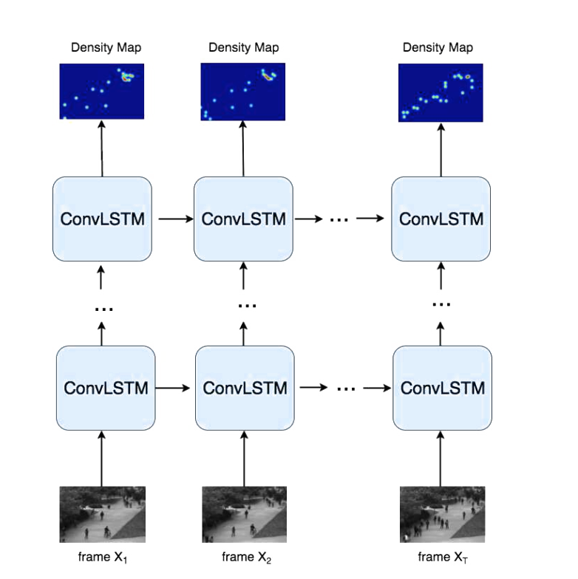
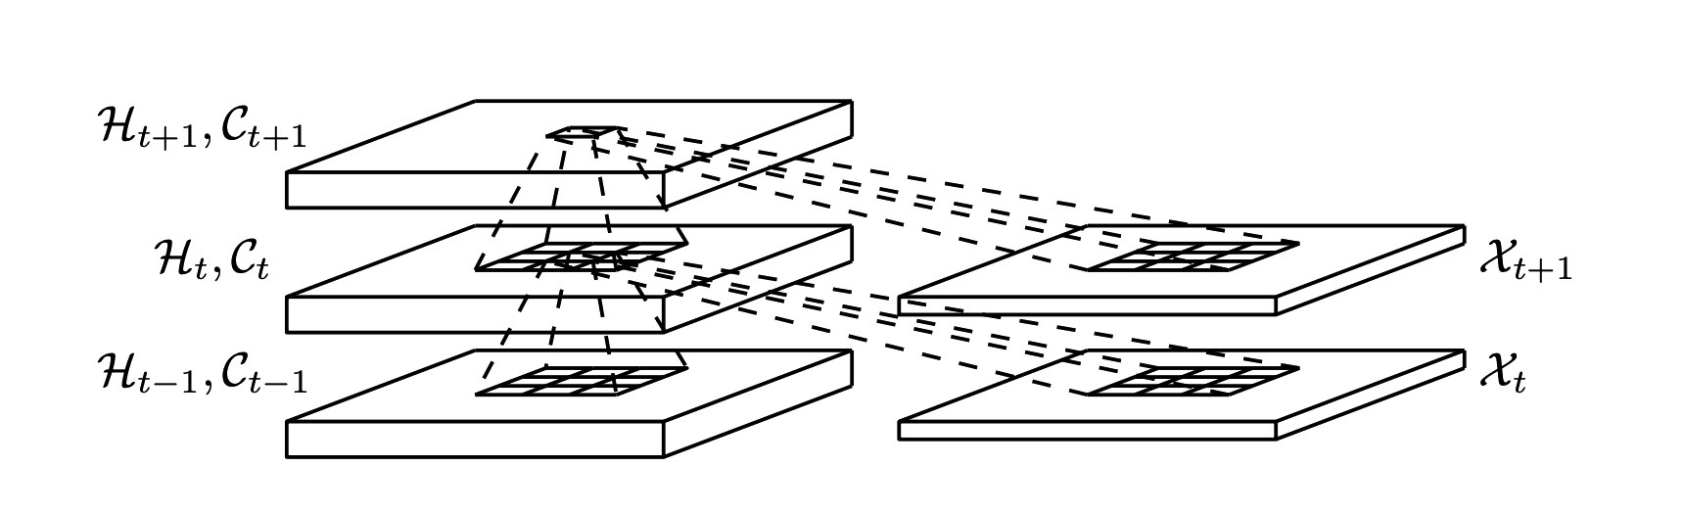
Time-based(Conv LSTM)
Spatiotemporal Modeling for Crowd Counting in Videos(ICCV 2017)

Slide 23
Result
Dataset: ShanghaiTech | MAE(paper’s/ours) | MSE(paper’s/ours)
MCNN | 110/110.8 | 170/167.3
TDF Net | 97.5/110.1 | 145/160
CSR Net | 68.2/130 | 115/190
Unlabeled Net | 72/130 | 106.4/160
SA Net | 67/300 | 104.5/400
Dataset: Mall | MAE(paper’s/ours) | MSE(paper’s/ours)
SA Net | Null/2.6 | Null/9.22
ConvLSTM | 1.3/6.2 | 1.79/36.36
ScaleConv2LSTM | Null/1.77 | Null/6.88

Slide 24
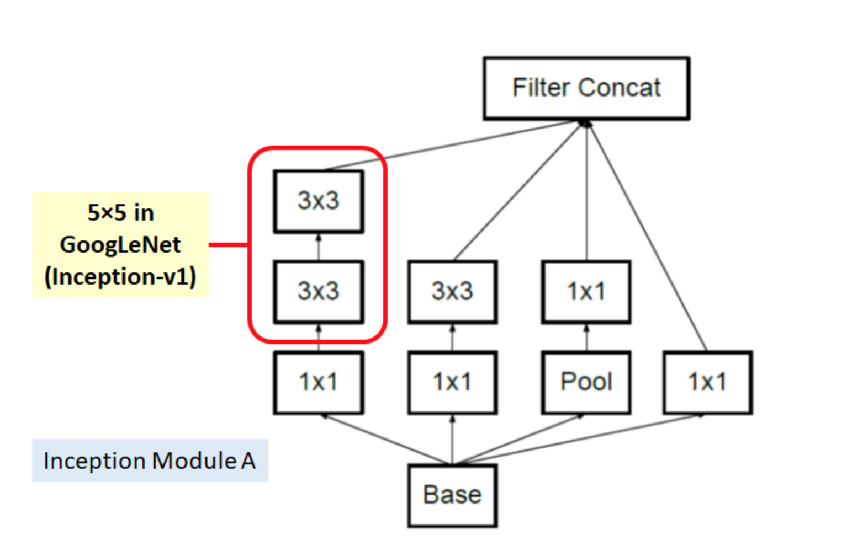
Inception

Slide 25
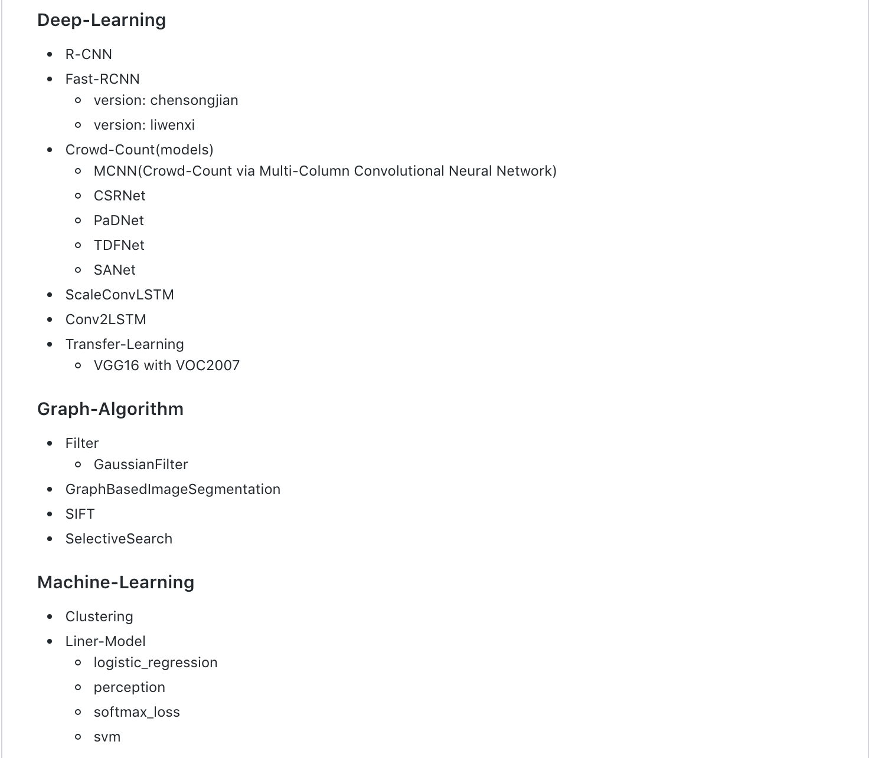
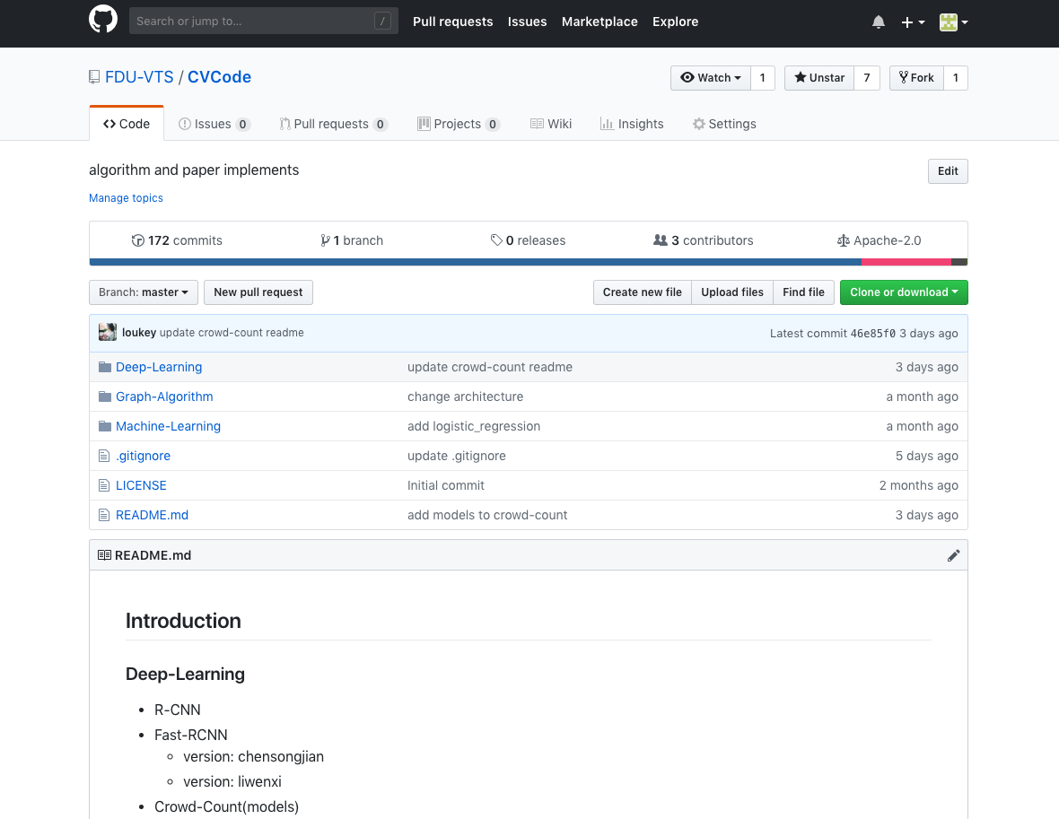
Codes
https://github.com/FDU-VTS/CVCode

Slide 26
THANKS

